Slide 1
Class Setup
Register - https://academy.databricks.com/class/register
Codes: Americas West: A1O0K9 ; Americas East: Z3J7L2; EMEA: H0M3N8; India/APAC: I0V8C1; ANZ/Japan/GCR: Q5V2W1
Demos/Hands-On (Linked above in Databricks Academy)
If you want to follow along please have a Databricks workspace and a DBR 6.x cluster ready
Capstone (Linked above in Databricks Academy) - Databricks Essentials Certification and Badge
Submit finished notebook to:
adb-certification@databricks.com
Due October 1st!
Passing “Capstone” notebooks will receive the Databricks Essentials Certification and Badge
Today’s Slides
Link:

Slide 2
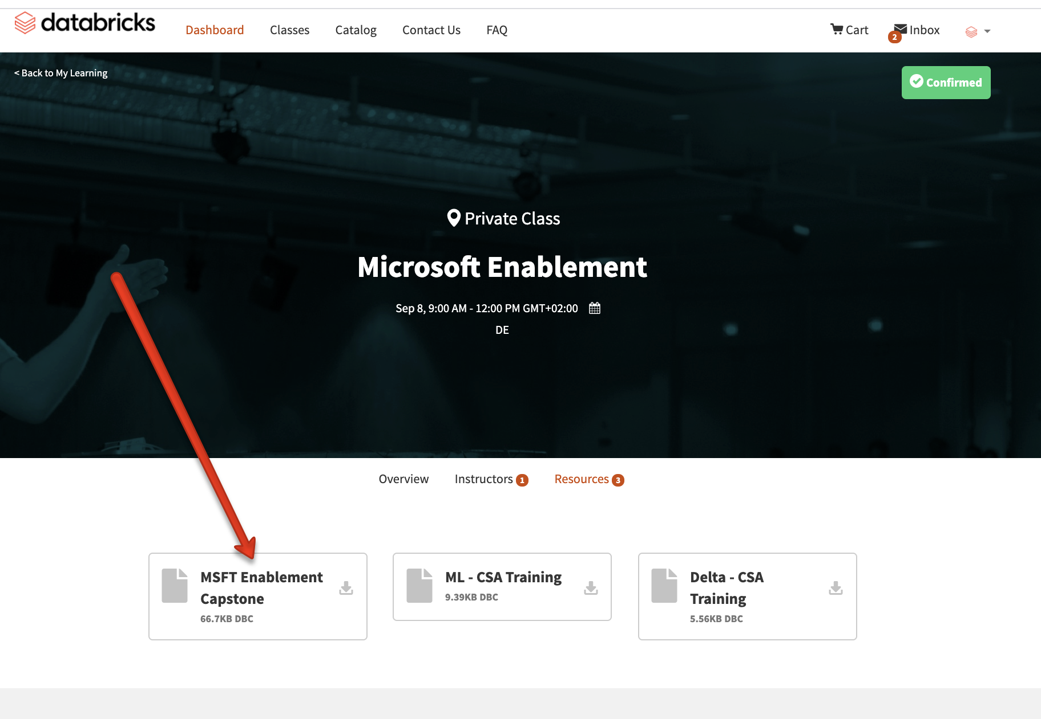
Capstone
Register - https://academy.databricks.com/class/register
Capstone Notebook (Homework) - Linked above in Databricks Academy “MSFT Enablement Capstone”
Submit finished notebook to:
adb-certification@databricks.com
Due October 1st!
Passing “Capstone” notebooks will receive the Databricks Essentials Certification and Badge

Slide 3

Name
Name
Solution Architect @databricks since ____
Based out of _____
Supports ____ Region
my.email@databricks.com
Solution Architect @databricks since ____
Based out of _____
Supports _______
my.email@databricks.com

Slide 4
Agenda
Introductions & What’s New in Azure Databricks
Modern Data Architecture with Azure Databricks & Synapse
Delta Demo & Code Along (Notebooks in https://academy.databricks.com/class/register)
Competitive Plays & Positioning
Break (~15min)
Machine Learning With Azure Databricks
Machine Learning Demo & Code Along (Notebooks in https://academy.databricks.com/class/register)
Hadoop Migrations & Vertical Plays
Wrap Up & Capstone

Slide 5
Agenda
Introductions & What’s New in Azure Databricks
Modern Data Architecture with Azure Databricks & Synapse
Delta Demo & Code Along (Notebooks in https://academy.databricks.com/class/register)
Competitive Plays & Positioning
Break (~15min)
Machine Learning With Azure Databricks
Machine Learning Demo & Code Along (Notebooks in https://academy.databricks.com/class/register)
Hadoop Migrations & Vertical Plays
Wrap Up & Capstone

Slide 6
Azure Databricks
Helping data teams solve the world’s toughest problems

Slide 7



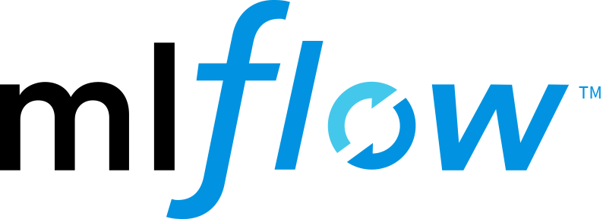

Unified data analytics platform for accelerating innovation across data science, data engineering, and business analytics
Global company with 5,000 customers and 450+ partners
Original creators of popular data and machine learning open source projects
Notes:
Azure Databricks provides a unified data analytics platform to accelerate your data-driven innovation.
We bring together data science, data engineering and business analytics in one platform.
We are a global company with more than 5,000 customers across various industries and we have more than 450 partners worldwide.
And most of you might have heard of Databricks as the creator of Spark, Delta Lake, and Mlflow – open source projects that are leading the innovation in the field of data and machine learning.
We continue to contribute and nurture these open source communities.

Slide 8


First party service
Enterprise-ready: secure & compliant
Native integration with Azure services
Partner ecosystem ready
Notes:
First Party Service: No friction sign-up on Azure. Customers sign up and use the service via the Azure portal. Single Azure bill. It has the same level of support and uses the same sales process as other Microsoft services, such as Azure Synapse Analytics and HDInsight.
Enterprise-Ready: Secure & Compliant: Meets Microsoft Azure service security and compliance standards. Out-of-box integration with AAD and role-based access.
Native Integration with Azure Services: Integrate seamlessly with other Azure services- Blob Storage, Data Lake Store, Azure Synapse Analytics, Cosmos DB, and more.

Slide 9
Amazing growth in the first 2 years
Thousands
Azure Databricks customers globally
Millions
Server-hours spinning up every day
2 Exabytes
Data processed per month
30+
Regions available worldwide
Notes:
Azure Databricks is being used by thousands of global customers are achieving phenomenal results! We now see millions of server-hours spinning up every day. 2 exabytes (2 billion gigabytes) of data are processed per month and Azure Databricks is available in 30 Regions worldwide.
https://databricks.com/blog/2019/11/20/azure-databricks-highlights-adoption-of-delta-lake-mlflow-and-integration-with-azure-machine-learning-at-microsoft-ignite-2019.html

Slide 10

Open-source storage layer that brings ACID transactions to Apache Spark™ and big data workloads.
75%
of the data processed in Azure Databricks is Delta
Notes:
Delta Lake is an open source storage layer that brings reliability to data lakes. Delta Lake provides ACID transactions, scalable metadata handling, and unifies streaming and batch data processing. Delta Lake runs on top of your existing data lake and is fully compatible with Apache Spark APIs. At Microsoft Ignite, we announced that over 75% of data processed on Azure Databricks is in Delta Lake — the new open source standard for data lakes.
https://databricks.com/blog/2019/11/20/azure-databricks-highlights-adoption-of-delta-lake-mlflow-and-integration-with-azure-machine-learning-at-microsoft-ignite-2019.html https://databricks.com/product/delta-lake-on-databricks

Slide 11



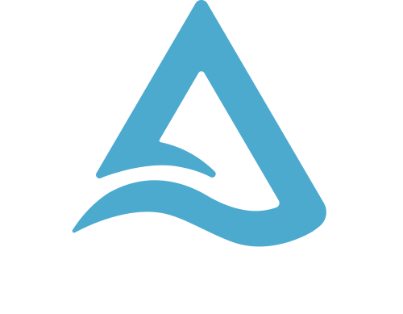




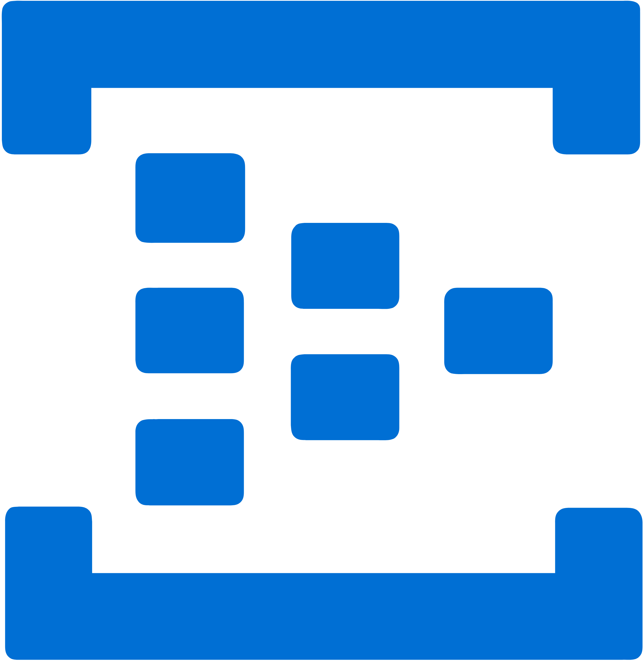




Azure Databricks
First-Party Service, Natively Integrated into Azure
Azure Data Factory
Azure Synapse Analytics
Azure Data Lake Storage
Azure Blob Storage
PowerBI
Integrated Data Services
End-to-End Analytics & ML
Azure Event Hubs
Azure Machine Learning
Azure Cosmos DB
Integrated Management
Azure Security
Azure Active Directory
Single Sign-On, Identity Passthrough, Network
Azure Portal
1-Click Setup
Unified Billing
Azure DevOps
Notebook integration
Notes:
The Azure Databricks Unified Analytics Platform integrates with your existing data and analytics ecosystem. It works seamlessly in the Azure ecosystem.
You can use Azure services such as Azure Data Factory, Azure Data Lake Storage, Azure Blob Storage, Azure Event Hubs, and Azure Cosmos DB to feed data into the Delta Lake and Azure Databricks. Data science teams can use their favorite IDE’s such as Jupyter, Rstudio, PyCharm, or IntelliJ to interact with data in Delta Lake and leverage Conda environment within the Databricks Workspace which is tightly integrated with GitHub. And the models created on Databricks can be deployed directly onto Azure ML or on-premises.
We also provide native connectors for BI tools such as Power BI to enable easy and seamless access to all your data in Delta Lake. You can also move data from Delta Lake to Azure Synapse Analytics to run any specialized analytics workloads. You can also use our optimized Spark engine within your existing ETL tools such as Informatica or Talend.

Slide 12

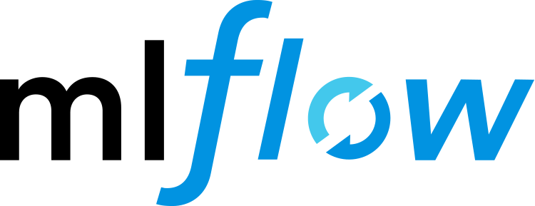



– Architecture Example
Ingest
Store
Prep and Train
Serve
+
Model Serving
Sensors and IoT
(unstructured)
Azure Kubernetes Service
Operational Databases
Apps
Logs (unstructured)
Azure Event Hubs
Azure IoT Hub
Kafka
Cosmos DB,
SQL DB
Azure Databricks
Ad-hoc
Analysis
Media (unstructured)
Azure Data Lake Storage
Files (unstructured)
Azure Data Factory
Azure Synapse Data Warehouse
Power BI
Business/custom apps
(structured)
Raw Format
Delta Format

Slide 13
Qualification / Sizing
Notes:
Welcome to the Databricks Overview. Thank you for joining us today.

Slide 14
How to technically qualify a customer:
 | Azure Ready | Data | Big Data Expertise | User Personas | Timeline to Prod
Great | All Project Data in Azure | 10TB + | In Production with Spark/Hadoop | Combination of "true" Data Engineers, Scientist and Advanced Analysts | ASAP
Good | Most Project Data in Azure | 1-10TB | Production Hadoop / Moving to Spark | Single Team of "true" Data Engineers or Data Scientists | 1-3 months
Okay | Some Project Data in Azure | 100GB - 1TB | Learning/New to Hadoop or Spark. MPPs Only (SAP Hana, Teradata, etc) | Tradition GUI based ETL Users (Informatica, Talend, SSIS, etc.) , "Aspirational" Data Scientists, SQL only Analyst | 3-12 months
Effort | No Project Data in Azure | <100GB | No Big Data Tools |  | 12+ months

Slide 15
Rough T-Shirt Sizing:
 |  | DATA VOLUMES
 |  | MBs (Total) | <100GB | 100GB - 1TB | 1TB - 100TB | 100TB - 1PB | 1PB+
 |  | MBs/day | GBs/day | 10sGB/day | 100sGB/day | TBs/day | 10+TB/day |  | Color Code | ~DBCUs ($)per year
USE CASES | ETL - Light Processing |  |  |  |  |  |  |  |  | 1,000s
 | Ad-Hoc Analytics - Light |  |  |  |  |  |  |  |  | 10,000s
 | ML - Scoring |  |  |  |  |  |  |  |  | (low) 100,000s
 | ML - Training |  |  |  |  |  |  |  |  | (high) 100,000s
 | Ad-Hoc Analytics - Heavy |  |  |  |  |  |  |  |  | 1,000,000+
 | ETL - Heavy Processing
 | Streaming
 | ML - Hyperparameter Tuning
 | Deep Learning

Slide 16
What is New in
Azure Databricks
Notes:
Welcome to the Databricks Overview. Thank you for joining us today.

Slide 17
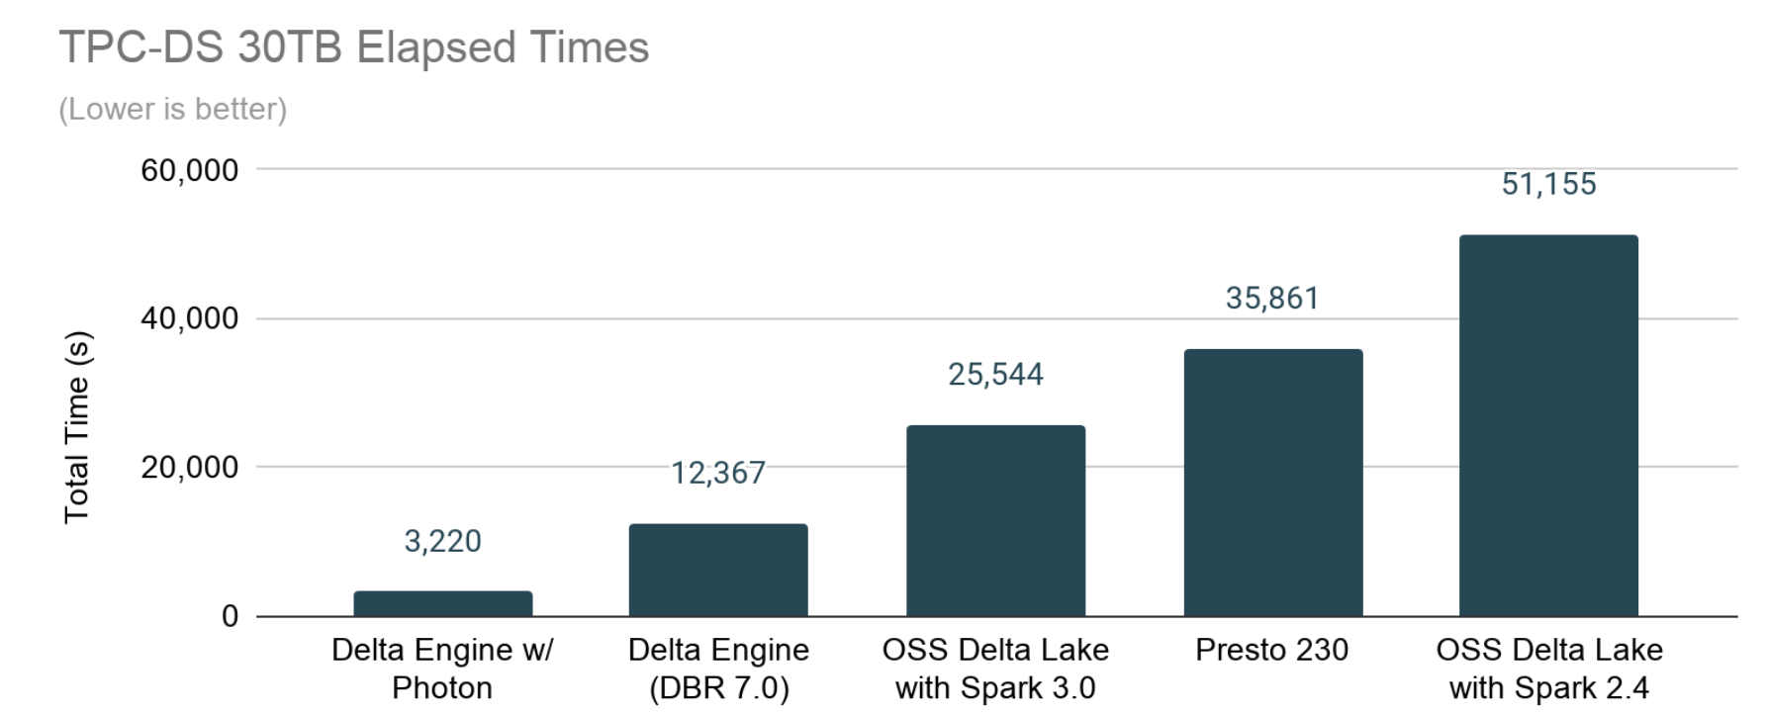
Databricks Runtime 7.0
GA - AVAILABLE NOW!
The first Databricks Runtime Release with:
Spark 3.0
Adaptive Query Execution
GPU/Accelerator aware Scheduler
Dynamic Partition Pruning

Slide 18
Databricks Pools
GA - AVAILABLE NOW!
Keep machines warm for fast jobs, fast autoscaling, and resource optimization
ADDING SUPPORT HETEROGENEOUS MACHINE TYPES BETWEEN DRIVERS AND WORKERS; SUPPORT AWS SPOT FLEET IN 2020
POOL
CLUSTER
Only infrastructure costs (no DBUs)
Can act as cache so no cost overnight (if no demand)
Accelerates both interactive and automated
Default DBR etc for fast start
instance
need new instance
container
container
instance
DBR
DBR
instance
seconds
instance
default DBR
minutes
cloud infrastructure
ENTERPRISE CLOUD PLATFORM

Slide 19






IP Access Lists
GA - AVAILABLE NOW!
Control the networks that can access databricks
HQ
✓
Databricks control plane
216.58.76.12/28
BRANCH
✓
UI
72.12.84.112,
72.12.84.116
</API>
Dynamically update the list of networks
ALLOW
DENY
216.58.76.12/28
216.58.76.15
Deny IPs within a permitted subnet to shrink exposure
72.12.84.112
Enterprise Cloud Service
✘
72.12.84.116
65.125.5.6

Slide 20
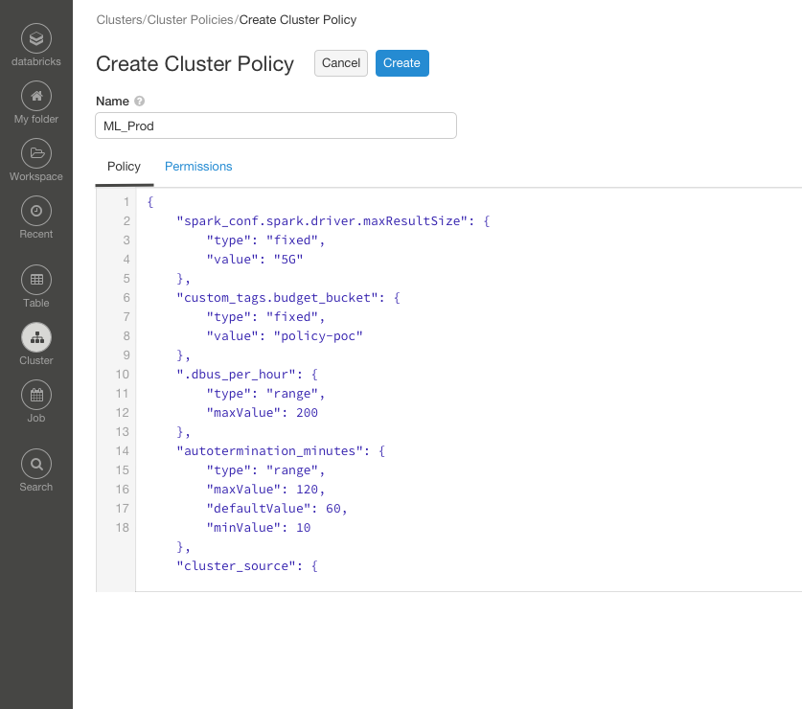
Cluster Policies
CURRENTLY PREVIEW
Control what specs users can configure when creating clusters
Cluster Policies can enforce or suggest configurations when creating a cluster to help admins achieve:
Cost control & allocation to BUs
Enforce Security & Compliance
Ensure Stability & Supportability
Remove complexity from daily users by hiding fixed values and/or suggesting optimal configs
Enterprise Cloud Service

Slide 21


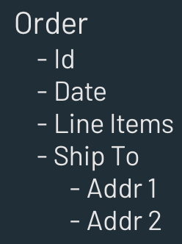
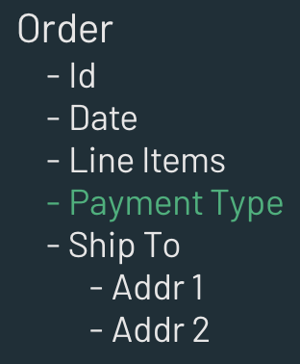
Ingestion Enhancements
GA - AVAILABLE NOW!
1
Auto Loader
Stream ingest files with directory listing
Quick stream ingestion of Cloud files (without queues)
Separate security setup APIs for Admins
2
Schema Inference & Drift handling
Automatically infer schema of incoming files into Auto Loader
Once configured, track schema changes and handle schema drift

Slide 22

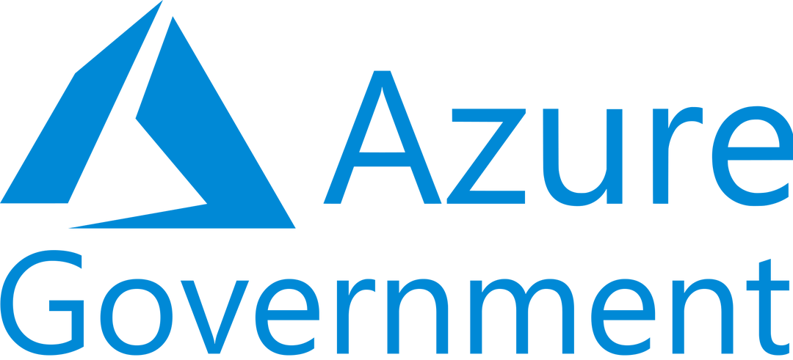

Azure Gov Cloud & FedRAMP
CURRENTLY PREVIEW
CURRENTLY PREVIEW
FedRAMP High Public
US East
US West2
US South Central
FedRAMP High GovCloud
Azure China (Mooncake)
CURRENTLY PREVIEW
Azure Databricks available in China
Gated Public Preview in Calendar Q3
GA in Calendar Q4

Slide 23
What is Coming Soon in
Azure Databricks

Slide 24


BI Experience
Optimized BI & SQL experience on Data Lakes
PERFORMANCE
POWER BI CONNECTOR
Low Delta Metadata Latency
Improved read performance regardless of number of Delta tables in a query or table sizes
Simple configuration dialog
Reliable connections using latest Databricks drivers
Azure AD authentication support
Seamless SSO experience
Optimized ODBC/JDBC Drivers
Wire protocol re-engineered to provide lower latencies & higher data transfer speeds

Slide 25
Delta Engine - with Photon
New, state-of-the-art execution engine for blazing fast Spark
Purpose-built Engine for Speed
Efficient memory management
Vectorization - optimized for modern hardware
Structured and semi-structured data workloads
Open Source Spark API compatible
Transparent to users
Delta Engine Performance Comparisons vs OSS 30TB TPC-DS

Slide 26
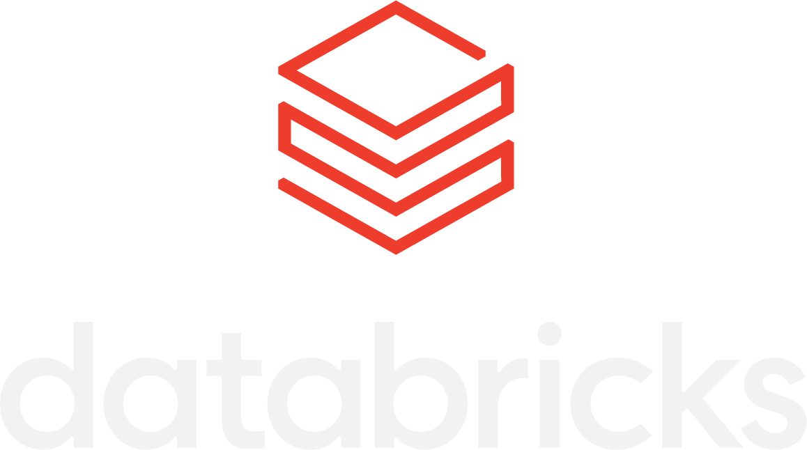








Projects API for CI/CD integration
Development / Experimentation
Production Jobs
dev
main
Programmatically manage Projects
Projects Service
Projects API
E.g., set up automation to automatically create Projects for all of your repositories
Perform Git operations on Projects
E.g., set up automation to always keep Projects in a production folder at a specified version
Git / CI/CD Systems
Version
Review
Test
Specify Git branch, tag, hash for Jobs
E.g., configure a Job to always run at a specific version

Slide 27



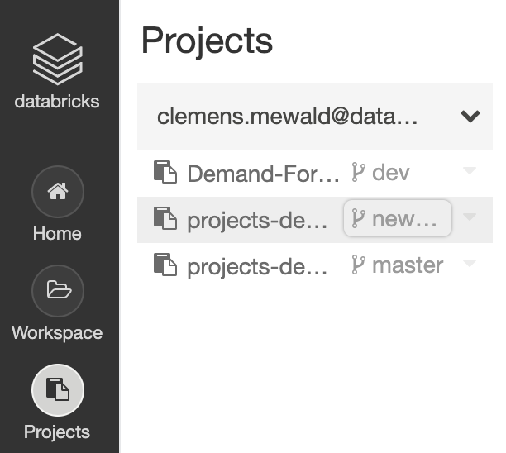
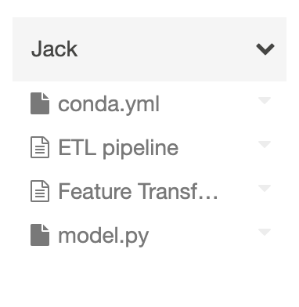

Data Science Workspace Innovations
.PY
.TXT
.YML
...
COLLABORATE ON GIT-BASED PROJECTS
FOLLOW BEST PRACTICES FOR PRODUCTION GRADE PROJECTS
SEAMLESSLY LAUNCH DEVELOPER ENVIRONMENTS AT SCALE
Customized Environment
Conda-based Runtime
Each project synced to a Git Repository
Support for arbitrary files, e.g. for factoring notebooks into libraries

Slide 28
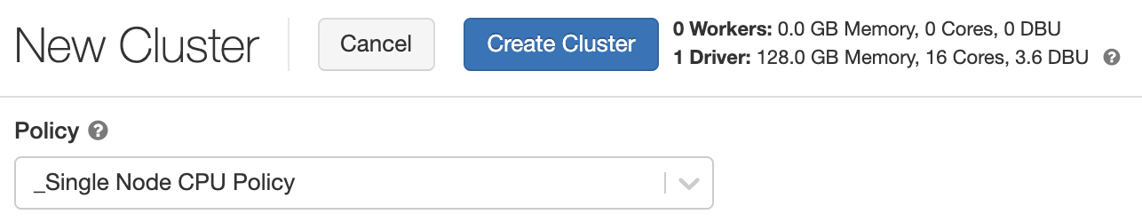
Improved Single-node Clusters and ML Training
Cluster policy for single node clusters (driver only) and improvements for single-node ML training
Default cluster policies for single-node CPU and GPU clusters
First-class support for Spark in local mode
Improvements to Spark DF <> Pandas DF conversion

Slide 29
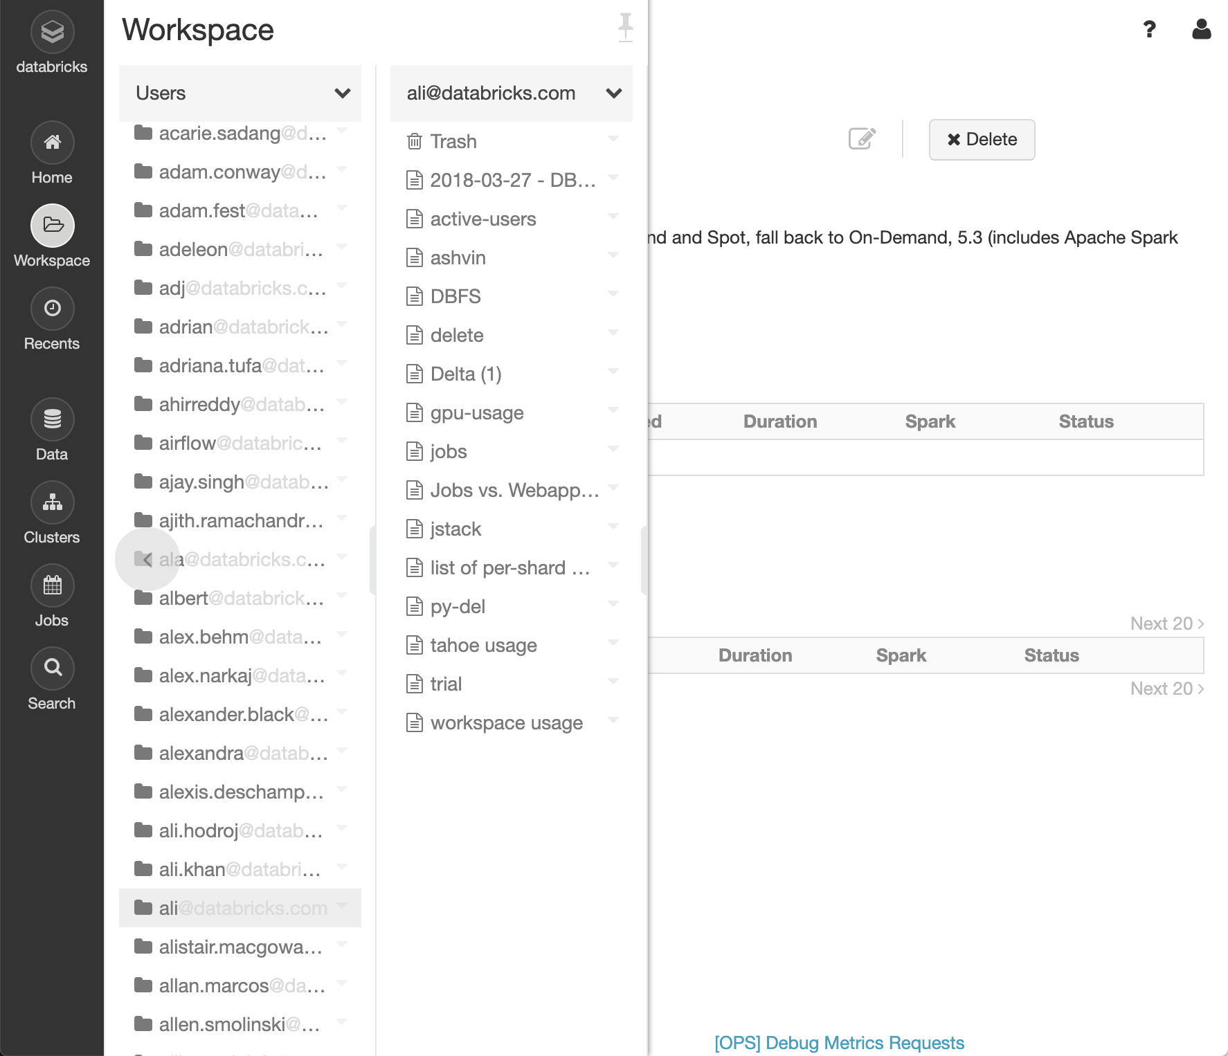

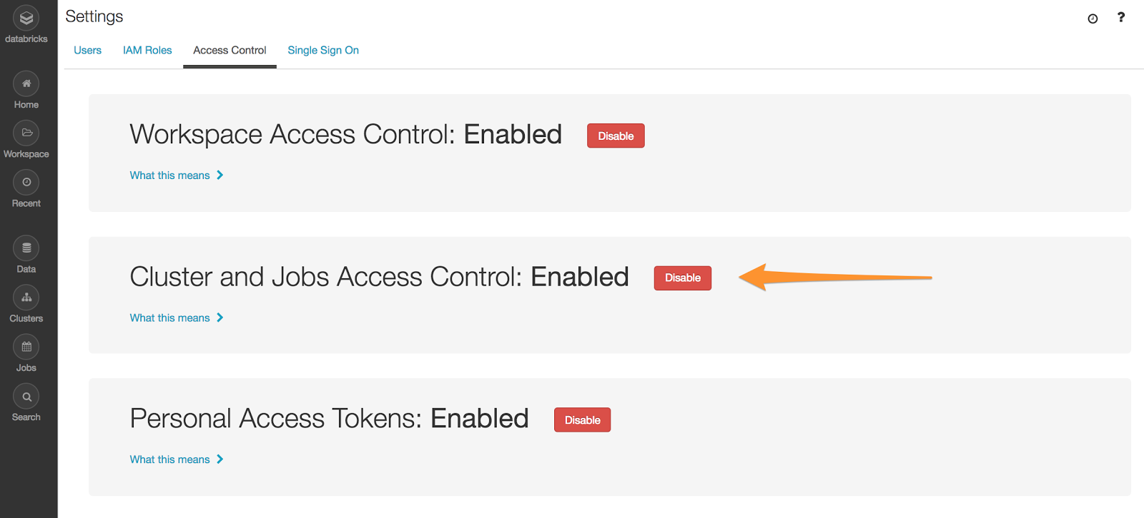
Enhanced Workspace Access Control
Restrict Notebooks, Clusters and Jobs to users with View permission
NOTEBOOKS
CLUSTERS
JOBS
Opt-in Setting
Opt-in at workspace via admin setting
Simplified User Experience
Only show items user can view
Works in UI and API

Slide 30
Secure network connectivity (No Public IPs)
CURRENTLY PRIVATE PREVIEW
Databricks control plane services
/cluster 1
/cluster 2
/cluster 3
/cluster 4
New scalable relay enables large number of encrypted connections for 1000s of clusters
Only outbound connections from enterprise environments
TLS 1.2 - Encrypted connections
Enterprise owned VNETs
VNET
VNET
VNET

Slide 31







Azure Native Private link
Azure private network
Control plane VNET
HQ
VNET
Express route
Jobs
10.1.0.1
10.2.0.10
Webapp
Private endpoint
Private Link Service endpoint
API Proxy
Cluster manager
216.58.76.12/28
Ver
Class
Flow label
Payload length
Next hdr
Hops
Validate that endpoint id matches workspace id
Source V6 address (private endpoint id)
Destination V6 address (load balancer IP)
IPV4 PAYLOAD (actual packet)
Third party vendors can’t do this

Slide 32
Thank You
Notes:
Welcome to the Databricks Overview. Thank you for joining us today.

